Slide 1

New Schools in the United States
A Quantitative Review of New Public Schools Opened Over the Last Three Decades
May 2023
Jesse Margolis
jesse@margrady.com

Slide 2
Background & Overview
In recent decades, the creation of new public schools has been an important initiative to improve the nation’s K-12 education system
The development of a new school can take many forms, from the construction of an elementary school to address population growth, to a collection of new, small high schools that replace a large failing school, to a charter school experimenting with new methods of education
State and local governments have invested significant time and money in new school creation, often supported by philanthropy
However, we are unaware of a comprehensive study of the number, type, and characteristics of new public schools opened in recent years
  The goal of this research project is to provide a comprehensive, quantitative review of new public schools opened in the United States over the past three decades

Slide 3
Agenda
National Overview
New York City Case Study
Appendix

Slide 4
As of 2019-20, nearly 17 million children, one-third of all public school students, attended schools that were started in the last 30 years.
93,502 public elementary and secondary schools in 2019-20
(50.4 million students)
61,590 schools started prior to 1990
10,010 schools started in the 1990s
5.4M students
12,382 schools started in the 2000s
7.2M students
9,520 schools started in the 2010s
33.5M students
4.3M students
61,590 existing schools started prior to 1990
(33.5 million students)
31,912 new schools
(16.9 million students)
Source: NCES CCD. Note: Includes only schools in the 50 states plus the District of Columbia that had students enrolled in grades PK through 13. Excludes correctional facilities, district offices, hospital / homebound students, and schools that have fewer than 25 students in all years. A new school is defined here as a school with students enrolled in 2019-20 that had no students enrolled in 1989-90.

Slide 5
Over the last three decades, the peak years of new school creation were between 1996 and 2010.
Number of New Schools Opened by Year
(1990-91 to 2019-20)
Peak Years
Number of Schools
Source: NCES Common Core of Data. Note: Includes only schools in the 50 states plus the District of Columbia that had students enrolled in grades PK through 13. Excludes correctional facilities, district offices, hospital/homebound students, and schools that have fewer than 25 students in all years. A new school is defined here as a school with students enrolled in the year shown that had no students enrolled the year prior and no students enrolled in 1989-90. If a school opens multiple times by this definition, it is considered to be a new school in the year it first opened.

Slide 6
NCES began tracking charter schools in 1998-99; in recent years, charters have accounted for approximately 40% of all new public schools.
Number of New Schools Opened by Year
(1990-91 to 2019-20)
Charters represent:
4% of new schools in the 1990s
24% of new schools in the 2000s
40% of new schools in the 2010s
Number of Schools
Source: NCES Common Core of Data. Note: Includes only schools in the 50 states plus the District of Columbia that had students enrolled in grades PK through 13. Excludes correctional facilities, district offices, hospital/homebound students, and schools that have fewer than 25 students in all years. A new school is defined here as a school with students enrolled in the year shown that had no students enrolled the year prior and no students enrolled in 1989-90. If a school opens multiple times by this definition, it is considered to be a new school in the year it first opened.

Slide 7
As of 2019-20, students enrolled in new schools are more likely to be Black or Hispanic and less likely to be White.
Proportion of Students Enrolled by Race / Ethnicity (2019-20)
Proportion of Students Enrolled by Race / Ethnicity
Source: NCES CCD. Note: Includes only schools in the 50 states plus the District of Columbia that had students enrolled in grades PK through 13. Excludes correctional facilities, district offices, hospital / homebound students, and schools that have fewer than 25 students in all years. A new school is defined here as a school with students enrolled in 2019-20 that had no students enrolled in 1989-90.

Slide 8
This trend is especially true for schools started more recently. New schools opened in the last decade have the lowest proportion of White students.
Proportion of Students Enrolled by Race / Ethnicity (2019-20)
Proportion of Students Enrolled by Race / Ethnicity
Source: NCES CCD. Note: Includes only schools in the 50 states plus the District of Columbia that had students enrolled in grades PK through 13. Excludes correctional facilities, district offices, hospital / homebound students, and schools that have fewer than 25 students in all years. A new school is defined here as a school with students enrolled in 2019-20 that had no students enrolled in 1989-90.

Slide 9
These trends are largely driven by the growth of charter schools, which tend to enroll a higher share of Black and Hispanic students than district schools.
District Schools (2019-20)
Proportion of Students Enrolled by Race / Ethnicity
Charter Schools (2019-20)
(Dashed line shows existing district schools as a reference point)
Proportion of Students Enrolled by Race / Ethnicity
Source: NCES CCD. Note: Includes only schools in the 50 states plus the District of Columbia that had students enrolled in grades PK through 13. Excludes correctional facilities, district offices, hospital / homebound students, and schools that have fewer than 25 students in all years. A new school is defined here as a school with students enrolled in 2019-20 that had no students enrolled in 1989-90.

Slide 10
Compared to older schools, new schools are more likely to enroll middle school students and less likely to enroll high school students.
Proportion of Students Enrolled by Grade (2019-20)
Proportion of Students Enrolled by Grade
Source: NCES CCD. Note: Includes only schools in the 50 states plus the District of Columbia that had students enrolled in grades PK through 13. Excludes correctional facilities, district offices, hospital / homebound students, and schools that have fewer than 25 students in all years. A new school is defined here as a school with students enrolled in 2019-20 that had no students enrolled in 1989-90. Graph excludes students in PK, who represent 3.2% of new school enrollment, 2.4% of existing school enrollment, and 2.7% of all school enrollment.

Slide 11
Compared to older schools, new schools are less likely to enroll students who qualify for free or reduced-price lunch, a trend driven by district schools.
Proportion of Students Eligible for Free or Reduced Price Lunch
(2019-20)
Proportion of Enrolled Students (2019-20)
N/A
Source: NCES CCD. Note: Includes only schools in the 50 states plus the District of Columbia that had students enrolled in grades PK through 13. Excludes correctional facilities, district offices, hospital / homebound students, and schools that have fewer than 25 students in all years. A new school is defined here as a school with students enrolled in 2019-20 that had no students enrolled in 1989-90. Limited to schools where lunch status is reported.

Slide 12
There are 125 single-sex public schools in the United States, nearly all of which are new since 1989-90.
Number of Single Sex Schools (2019-20)
Number of Schools
Source: NCES CCD. Note: Includes only schools in the 50 states plus the District of Columbia that had students enrolled in grades PK through 13. Excludes correctional facilities, district offices, hospital / homebound students, and schools that have fewer than 25 students in all years. A new school is defined here as a school with students enrolled in 2019-20 that had no students enrolled in 1989-90. An all-boys school is defined as one with at least 100 students, of whom 99% or more are male. An all-girls schools is defined as one with at least 100 students, of whom 99% or more are female.

Slide 13
Of the 125 single-sex public schools currently open in the United States, most opened in the past 15 years.
Number of New Single-Sex Schools by Year Opened
(1990-91 to 2019-20)
Source: NCES CCD. Note: Includes only schools in the 50 states plus the District of Columbia that had students enrolled in grades PK through 13. Excludes correctional facilities, district offices, hospital / homebound students, and schools that have fewer than 25 students in all years. A new school is defined here as a school with students enrolled in 2019-20 that had no students enrolled in 1989-90. An all-boys school is defined as one with at least 100 students, of whom 99% or more are male. An all-girls schools is defined as one with at least 100 students, of whom 99% or more are female.
The year the school opened in defined as the first year after 1989-90 when students were enrolled. This chart excludes schools that closed prior to 2019-20. The graph excludes 8 all boys schools and 5 all girls schools that were open prior to 1990-91 (though these schools may or may not have been single-sex schools at that time).

Slide 14
Nationally, new schools started over the past 30 years enroll a similar number of students, on average, as older schools.
Average Number of Students per School (2019-20)
Some new schools opened in the 2010s are likely still phasing in
# of Schools: 61,590 10,010 12,382 9,520
Source: NCES CCD. Note: Includes only schools in the 50 states plus the District of Columbia that had students enrolled in grades PK through 13. Excludes correctional facilities, district offices, hospital / homebound students, and schools that have fewer than 25 students in all years. A new school is defined here as a school with students enrolled in 2019-20 that had no students enrolled in 1989-90.

Slide 15
There are more new schools – opened over the past 30 years – in New York City than in the next three districts combined.
25 School Districts with the Most New Schools Opened
Sorted
Source: NCES CCD. Note: Includes only schools in the 50 states plus the District of Columbia that had students enrolled in grades PK through 13. Excludes correctional facilities, district offices, hospital / homebound students, and schools that have fewer than 25 students in all years. A new school is defined here as a school with students enrolled in 2019-20 that had no students enrolled in 1989-90.
Note: New schools include only those that are still open in 2019-20. Charter schools have been assigned to their geographic district based on their address.

Slide 16
Agenda
National Overview
New York City Case Study
Appendix

Slide 17
In New York City, 57% of schools – enrolling 45% of students – were opened in the last three decades.
Schools and Students
(New York City, 2019-20)
Source: NCES Common Core of Data. Note: Includes only schools in New York City that had students enrolled in grades PK through 13. Excludes correctional facilities, district offices, hospital / homebound students, and schools that have fewer than 25 students in all years. A new school is defined here as a school with students enrolled in 2019-20 that had no students enrolled in 1989-90.

Slide 18
In New York City, the peak years for new school creation were between 2002-03 and 2013-14.
Number of New Schools in New York City Opened by Year
(1990-91 to 2019-20)
Peak Years
Source: NCES Common Core of Data. Note: Includes only schools in New York City that had students enrolled in grades PK through 13. Excludes correctional facilities, district offices, hospital/homebound students, and schools that have fewer than 25 students in all years. A new school is defined here as a school with students enrolled in the year shown that had no students enrolled the year prior and no students enrolled in 1989-90. If a school opens multiple times by this definition, it is considered to be a new school in the year it first opened.

Slide 19
Through 2014-15, the majority of new schools opened in New York City were district schools; since 2015-16, most new schools have been charters.
Number of New Schools in New York City Opened by Year
(1990-91 to 2019-20)
Charters represent:
17% of new schools in the 2000s
46% of new schools in the 2010s
Source: NCES Common Core of Data. Note: Includes only schools in New York City that had students enrolled in grades PK through 13. Excludes correctional facilities, district offices, hospital/homebound students, and schools that have fewer than 25 students in all years. A new school is defined here as a school with students enrolled in the year shown that had no students enrolled the year prior and no students enrolled in 1989-90. If a school opens multiple times by this definition, it is considered to be a new school in the year it first opened. Some charter schools in New York City opened prior to 2002-03, but it appears New York State did not begin submitting charter school data to NCES until 2002-03.

Slide 20
As of 2019-20, students enrolled in new schools in New York City were more likely to be Black or Hispanic and less likely to be Asian or White.
Proportion of Students Enrolled by Race / Ethnicity
(New York City, 2019-20)
Proportion of Students Enrolled
by Race / Ethnicity
Source: NCES Common Core of Data. Note: Includes only schools in New York City that had students enrolled in grades PK through 13. Excludes correctional facilities, district offices, hospital/homebound students, and schools that have fewer than 25 students in all years. A new school is defined here as a school with students enrolled in 2019-20 that had no students enrolled in 1989-90.

Slide 21
More recently opened schools have a higher share of Black students and a lower share of White and Asian students than schools started in prior decades.
Proportion of Students Enrolled by Race / Ethnicity
(New York City, 2019-20)
Proportion of Students Enrolled
by Race / Ethnicity
Source: NCES Common Core of Data. Note: Includes only schools in New York City that had students enrolled in grades PK through 13. Excludes correctional facilities, district offices, hospital/homebound students, and schools that have fewer than 25 students in all years. A new school is defined here as a school with students enrolled in 2019-20 that had no students enrolled in 1989-90.

Slide 22
New district schools enroll a higher share of Black and Latino students than older schools; charters have a substantially higher share of Black students.
District Schools (NYC, 2019-20)
Proportion of Students Enrolled by Race / Ethnicity
Charter Schools (NYC, 2019-20)
(Dashed line shows existing district schools as a reference point)
Proportion of Students Enrolled by Race / Ethnicity
Source: NCES Common Core of Data. Note: Includes only schools in New York City that had students enrolled in grades PK through 13. Excludes correctional facilities, district offices, hospital / homebound students, and schools that have fewer than 25 students in all years. A new school is defined here as a school with students enrolled in 2019-20 that had no students enrolled in 1989-90.

Slide 23
Compared to older schools, new schools in NYC are more likely to enroll high school students and less likely to enroll elementary school students.
Proportion of Students Enrolled by Grade
(New York City, 2019-20)
Proportion of Students Enrolled by Grade
Source: NCES Common Core of Data. Note: Includes only schools in New York City that had students enrolled in grades PK through 13. Excludes correctional facilities, district offices, hospital / homebound students, and schools that have fewer than 25 students in all years. A new school is defined here as a school with students enrolled in 2019-20 that had no students enrolled in 1989-90. Graph excludes students in PK, who represent 1.5% of new school enrollment, 3.9% of existing school enrollment, and 2.8% of all school enrollment.

Slide 24
In New York City, this trend is driven by new district schools, which have focused primarily on grades 9-12 and secondarily on grades 6-8.
Proportion of Students Enrolled by Grade
(New York City - New District vs. New Charter Schools, 2019-20)
Proportion of Students Enrolled by Grade
Source: NCES Common Core of Data. Note: Includes only schools in New York City that had students enrolled in grades PK through 13. Excludes correctional facilities, district offices, hospital/homebound students, and schools that have fewer than 25 students in all years. A new school is defined here as a school with students enrolled in 2019-20 that had no students enrolled in 1989-90. Graph excludes students in PK, who represent 2.0% of new district school enrollment and 0.0% of new charter school enrollment.

Slide 25
Compared to older schools, new schools in New York City are more likely to enroll students who qualify for free or reduced-price lunch.
Proportion of Students Eligible for Free or Reduced Price Lunch
(2019-20)
Proportion of Enrolled Students (2019-20)
N/A
Source: NCES Common Core of Data. Note: Includes only schools in New York City that had students enrolled in grades PK through 13. Excludes correctional facilities, district offices, hospital/homebound students, and schools that have fewer than 25 students in all years. A new school is defined here as a school with students enrolled in 2019-20 that had no students enrolled in 1989-90. Limited to schools where lunch status is reported.

Slide 26
New York City has 13 all-girls schools and 8 all-boys public schools, 17% of all single-sex public schools nationally.
Source: NCES CCD. Note: Includes only schools in New York City that had students enrolled in grades PK through 13. Excludes correctional facilities, district offices, hospital / homebound students, and schools that have fewer than 25 students in all years. A new school is defined here as a school with students enrolled in 2019-20 that had no students enrolled in 1989-90. An all-boys school is defined as one with at least 100 students, of whom 99% or more are male. An all-girls schools is defined as one with at least 100 students, of whom 99% or more are female. The Urban Assembly School for Criminal Justice is now called the Urban Assembly School for Leadership and Empowerment.

Slide 27
In New York City, schools that started in the 2000s are 37% smaller than schools that started prior to 1990-91.
Average Number of Students per School
(New York City, 2019-20)
Some new schools started in the 2010s are likely still phasing in
# of Schools: 791 170 513 367
This trend is particularly notable given that many new schools in NYC are high schools, and high schools tend to be larger than elementary schools.
Source: NCES Common Core of Data. Note: Includes only schools in New York City that had students enrolled in grades PK through 13. Excludes correctional facilities, district offices, hospital/homebound students, and schools that have fewer than 25 students in all years. A new school is defined here as a school with students enrolled in 2019-20 that had no students enrolled in 1989-90.

Slide 28
In New York City, new high schools are much smaller than older high schools, opened prior to 1990-91.
Average Enrollment of Schools Attended by Students in Each Grade
(New York City, 2019-20)
In New York City, the average enrollment of an older school (opened prior to 1990-91) attended by 9th graders was 1,416 students, compared to 495 students for a new school started in the 2000s.
Source: NCES Common Core of Data. Note: Includes only schools in New York City that had students enrolled in grades PK through 13. Excludes correctional facilities, district offices, hospital/homebound students, and schools that have fewer than 25 students in all years. A new school is defined here as a school with students enrolled in 2019-20 that had no students enrolled in 1989-90.

Slide 29
In NYC, 62% of new schools share a location with another school, vs. 21% of older schools; nationally, the numbers are 18% and 10%, respectively
Number of Schools Sharing a Location
(2019-20)
New York City
United States
Source: NCES CCD. NCES Common Core of Data. Note: Includes only schools in in the 50 states and DC that had students enrolled in grades PK through 13. Excludes correctional facilities, district offices, hospital/homebound students, and schools that have fewer than 25 students in all years. A new school is defined here as a school with students enrolled in 2019-20 that had no students enrolled in 1989-90. A school is defined to share a location with another school if the latitude and longitude coordinates in decimal (x-y) form are both within 0.001 of one another (between 0.07 to 0.10 miles, or between 350 to 500 feet). Latitude and Longitude conversion from https://www.meridianoutpost.com/resources/etools/calculators/calculator-latitude-longitude-distance.php

Slide 30
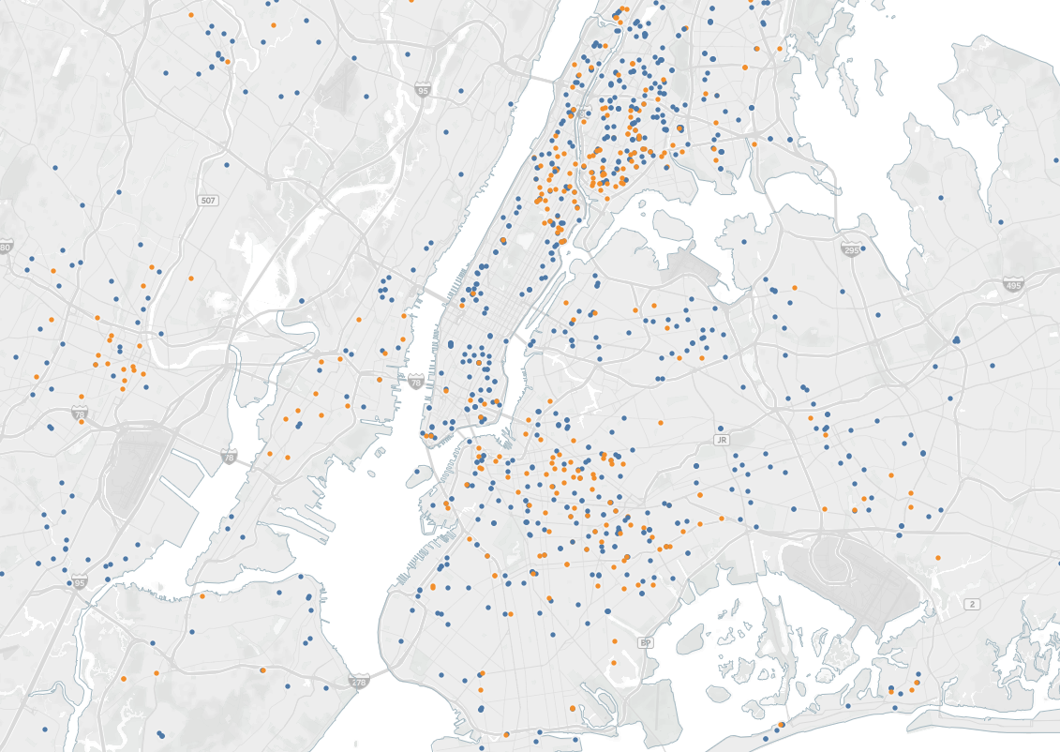
In New York City, most new schools are located in the Bronx, Harlem, the Lower East Side, and Central Brooklyn.
New Schools: 1990-91 to 2019-20
District school
Charter school
Interactive Map available at http://margrady.com/newschools
Source: NCES CCD. Note: Includes only schools in the 50 states plus the District of Columbia that had students enrolled in grades PK through 13. Excludes correctional facilities, district offices, hospital / homebound students, and schools that have fewer than 25 students in all years. A new school is defined here as a school with students enrolled in 2019-20 that had no students enrolled in 1989-90.

Slide 31
Acknowledgements
We would like to thank the Carnegie Corporation of New York for commissioning this research, especially Saskia Levy Thompson, Alexandra Cox, Kelly Devine, Debra Wexler, and Daniel Kitae Um. We are also grateful to Tom Vander Ark, Shael Suransky, Jen Holleran, and Michele Cahill for feedback on an early draft of this research. Eli Groves and Theo Kaufman provided excellent assistance with research and analysis to make this report possible.
MarGrady Research helps education leaders make better decisions to improve the lives of students. We do this through rigorous analysis of data, clear and insightful presentation of results, and the development of lasting partnerships with the school districts, foundations, and other education organizations we work with. Read more at www.margrady.com

Slide 32
Appendix
Appendix 1
Definitions

Slide 33
Definition of a School
In our analysis, we define a school as any unique NCES ID in the National Center for Education Statistics (NCES) Common Core of Data (CCD) enrollment file that has at least one student enrolled
We limit our analysis to schools in the 50 states and the District of Columbia
We also exclude from our analysis the following “schools” that appear in the CCD enrollment files:
  Correctional facilities: schools managed by a Department of Corrections or Prisons, schools with the word “jail” or “juvenile” in their name, or other schools whose name clearly indicates that they are correctional facilities
  District offices: schools that appeared to administratively assign students to a district or state office. These include County Superintendent’s Offices in Florida and BOCES in New York.
  Hospital / homebound students: schools with the word “hospital” or “homebound” in their name. Schools run by a State Department of Mental Health are also excluded.
  Schools with fewer than 25 students in all years: any school that never had 25 or more students enrolled in any year from 1989-90 to 2019-20.

Slide 34
Definition of a New School
The unique school identifier for this analysis is the NCES ID from the CCD*
However, analyzing new school creation using NCES IDs is challenging because the IDs can sometimes change from year-to-year for reasons other than what one would generally consider the closing of a school and the opening of another (e.g. a district merger, etc.)**
Therefore, our definition of a new school is a school that has a new NCES ID (not used previously in our data) and either a new name or new location
  New name: a name that is not essentially the same as the name of a school in the same zip code that had non-zero enrollment the year before (e.g. “Anytown Elementary School” and “Anytown El” are considered to be essentially the same name)
  New location: an address in a different zip code
This definition has several important implications
  A school that maintains its NCES ID over time is not considered a new school, even if its name changes or it moves to a new location
  A new NCES ID is not considered a new school if both the name and location of the school essentially match the name and location of a school that had non-zero enrollment the year before
* Federal guidelines regarding the creation of new NCES IDs are described in Section 2.4.3.1.4 (Operational Status – When to Report as New) of “FS029 (Multiple DGs) — Directory v17.0”, available here: https://www2.ed.gov/about/inits/ed/edfacts/sy-20-21-nonxml.html
** See the 2019 NCES ID Report by the National Alliance for Public Charter Schools for a discussion of this issue as it relates to charters (https://www.publiccharters.org/sites/default/files/documents/2019-10/NCES-white-paper-final%20PUBLISH.pdf). This issue is also relevant for district schools.

Slide 35
Appendix
Appendix 2
Additional Detail and Breakdowns

Slide 36
Texas, California, and Florida had the largest net increase in schools, while West Virginia, and Pennsylvania and Iowa had the largest net decrease.
Number of Schools Opened and Closed from 1989-90 to 2019-20
(50 states & DC)
Source NCES Common Core of Data. Note: Includes only schools in the 50 states plus the District of Columbia that had students enrolled in grades PK through 13. Excludes correctional facilities, district offices, hospital/homebound students, and schools that have fewer than 25 students in all years. Schools Opened represent the number of schools open in 2019-20 that were not open in 1989-90. Schools Closed represent the number of schools that were open in 1989-90 but closed by 2019-20. Net new is equal to Schools Opened minus Schools Closed.

Slide 37
Nevada, Arizona, and Florida had the largest proportional increases in schools, while West Virginia, Maine, and North Dakota had the biggest decreases.
Percentage of Schools Opened and Closed Since 1989-90
(Proportional to Number of Schools in 1989-90)
Source: NCES Common Core of Data. “% Opened” represents the number of new schools opened between 1989-90 and 2019-20 divided by the number of schools in 1989-90. “% Closed” represents the number of schools closed between 1989-20 and 2019-20 divided by the number of schools in 1989-90. Net new is equal to % Opened minus % Closed.

Slide 38
Nationally, both new district and charter schools have an overrepresentation of middle school students and underrepresentation of high school students.
United States
Proportion of Students Enrolled by Grade
(New District vs. New Charter Schools, 2019-20)
Proportion of Students Enrolled by Grade
Source: NCES CCD. Note: Includes only schools in the 50 states plus the District of Columbia that had students enrolled in grades PK through 13. Excludes correctional facilities, district offices, hospital / homebound students, and schools that have fewer than 25 students in all years. A new school is defined here as a school with students enrolled in 2019-20 that had no students enrolled in 1989-90. Graph excludes students in PK, who represent 3.6% of new district school enrollment and 1.4% of new charter school.

Slide 39
The trends by decade are similar, with new district schools having a smaller share of FRPL students, on average, and charters having a higher share.
United States
Proportion of Students Eligible for Free or Reduced Price Lunch
(2019-20)
Proportion of Enrolled Students (2019-20)
Source: NCES CCD. Note: Includes only schools in the 50 states plus the District of Columbia that had students enrolled in grades PK through 13. Excludes correctional facilities, district offices, hospital / homebound students, and schools that have fewer than 25 students in all years. A new school is defined here as a school with students enrolled in 2019-20 that had no students enrolled in 1989-90. Limited to schools where lunch status is reported.

Slide 40
We see a similar picture when looking at the Income-to-Poverty Ratio, a measure of income in the neighborhood immediately surrounding a school.
United States
Income-to-Poverty Ratio (2019-20)
(Higher IPR → Higher Income Neighborhood)
Income-to-Poverty Ratio (IPR)
NCES began calculating IPR in 2016 to provide a measure of school neighborhood poverty
NCES uses data from the Census Bureau’s American Community Survey (ACS) to estimate the income for families who live near every public school (NCES looks at the 25 surveyed families with children age 5-18 who live closest to the school)
The IPR calculation divides the average income of the families who live near the school by the neighborhood poverty rate and multiplies the result by 100
The IPR has important limitations, most notably that it measures the income of the school’s neighborhood, not of the school’s student body
However, recent research finds the IPR to be a more valid measure of school socio-economic status than measures based on free lunch eligibility (Fazlul, Koedel, and Parsons, 2021)
Income to Poverty Ratio (2019-20)
Poverty
Line
N/A
New district schools are in neighborhoods with slightly higher income than older schools, while new charter schools are in lower-income neighborhoods.
Source: NCES CCD. Note: Includes only schools in the 50 states plus the District of Columbia that had students enrolled in grades PK through 13. Excludes correctional facilities, district offices, hospital / homebound students, and schools that have fewer than 25 students in all years. A new school is defined here as a school with students enrolled in 19-20 that had no students enrolled in 89-90. Fazlul, Koedel & Parsons, 2021, “Free and reduced-price meal eligibility does not measure student poverty: Evidence and policy significance.” Working Paper available here: https://www.edworkingpapers.com/ai21-415.

Slide 41
Among new district schools, those started in the last decade tend to be in lower income areas than those started in the 1990s or 2000s.
United States
Income-to-Poverty Ratio (2019-20)
(Higher IPR → Higher Income Neighborhood)
Income-to-Poverty Ratio (IPR)
NCES began calculating IPR in 2016 to provide a measure of school neighborhood poverty
NCES uses data from the Census Bureau’s American Community Survey (ACS) to estimate the income for families who live near every public school (NCES looks at the 25 surveyed families with children age 5-18 who live closest to the school)
The IPR calculation divides the average income of the families who live near the school by the neighborhood poverty rate and multiplies the result by 100
The IPR has important limitations, most notably that it measures the income of the school’s neighborhood, not of the school’s student body
However, recent research finds the IPR to be a more valid measure of school socio-economic status than measures based on free lunch eligibility (Fazlul, Koedel, and Parsons, 2021)
Income to Poverty Ratio (2019-20)
Poverty
Line
N/A
Charter schools started in all decades have, on average, been in lower income neighborhoods than new or older district schools
Source: NCES CCD. Note: Includes only schools in the 50 states plus the District of Columbia that had students enrolled in grades PK through 13. Excludes correctional facilities, district offices, hospital / homebound students, and schools that have fewer than 25 students in all years. A new school is defined here as a school with students enrolled in 19-20 that had no students enrolled in 89-90. Fazlul, Koedel & Parsons, 2021, “Free and reduced-price meal eligibility does not measure student poverty: Evidence and policy significance.” Working Paper available here: https://www.edworkingpapers.com/ai21-415.

Slide 42
New and older schools have a similar breakdown of students by sex.
United States
Proportion of Students Enrolled by Sex (2019-20)
Proportion of Students Enrolled by Sex
Source: NCES CCD. Note: Includes only schools in the 50 states plus the District of Columbia that had students enrolled in grades PK through 13. Excludes correctional facilities, district offices, hospital / homebound students, and schools that have fewer than 25 students in all years. A new school is defined here as a school with students enrolled in 2019-20 that had no students enrolled in 1989-90.

Slide 43
The trends by decade are similar, with new district and charter schools having a higher percentage of students eligible for free or reduced price lunch.
New York City
Proportion of Students Eligible for Free or Reduced Price Lunch
(2019-20)
Proportion of Enrolled Students (2019-20)
Source: NCES CCD. Note: Includes only schools in the 50 states plus the District of Columbia that had students enrolled in grades PK through 13. Excludes correctional facilities, district offices, hospital / homebound students, and schools that have fewer than 25 students in all years. A new school is defined here as a school with students enrolled in 2019-20 that had no students enrolled in 1989-90. Limited to schools where lunch status is reported.

Slide 44
When looking at the Income-to-Poverty Ratio, the lower average income level in new school neighborhoods appears to be driven primarily by charters.
New York City
Income-to-Poverty Ratio (2019-20)
(Higher IPR → Higher Income Neighborhood)
Income-to-Poverty Ratio (IPR)
NCES began calculating IPR in 2016 to provide a measure of school neighborhood poverty
NCES uses data from the Census Bureau’s American Community Survey (ACS) to estimate the income for families who live near every public school (NCES looks at the 25 surveyed families with children age 5-18 who live closest to the school)
The IPR calculation divides the average income of the families who live near the school by the neighborhood poverty rate and multiplies the result by 100
The IPR has important limitations, most notably that it measures the income of the school’s neighborhood, not of the school’s student body
However, recent research finds the IPR to be a more valid measure of school socio-economic status than measures based on free lunch eligibility (Fazlul, Koedel, and Parsons, 2021)
Income to Poverty Ratio (2019-20)
Poverty
Line
N/A
New district schools are in neighborhoods with slightly lower income than older schools, while new charter schools are in substantially lower-income neighborhoods.
Source: NCES CCD. Note: Includes only schools in New York City that had students enrolled in grades PK through 13. Excludes correctional facilities, district offices, hospital / homebound students, and schools that have fewer than 25 students in all years. A new school is defined here as a school with students enrolled in 19-20 that had no students enrolled in 89-90. Fazlul, Koedel & Parsons, 2021, “Free and reduced-price meal eligibility does not measure student poverty: Evidence and policy significance.” Working Paper available here: https://www.edworkingpapers.com/ai21-415.

Slide 45
The trends by decade in NYC show a more nuanced result; new district schools started in the 1990s are located in higher income neighborhoods.
New York City
Income-to-Poverty Ratio (2019-20)
(Higher IPR → Higher Income Neighborhood)
Income-to-Poverty Ratio (IPR)
NCES began calculating IPR in 2016 to provide a measure of school neighborhood poverty
NCES uses data from the Census Bureau’s American Community Survey (ACS) to estimate the income for families who live near every public school (NCES looks at the 25 surveyed families with children age 5-18 who live closest to the school)
The IPR calculation divides the average income of the families who live near the school by the neighborhood poverty rate and multiplies the result by 100
The IPR has important limitations, most notably that it measures the income of the school’s neighborhood, not of the school’s student body
However, recent research finds the IPR to be a more valid measure of school socio-economic status than measures based on free lunch eligibility (Fazlul, Koedel, and Parsons, 2021)
Income to Poverty Ratio (2019-20)
Poverty
Line
N/A
N/A
New district schools started in NYC in the 2000s and 2010s are located in lower income neighborhoods than older schools
Source: NCES CCD. Note: Includes only schools in New York City that had students enrolled in grades PK through 13. Excludes correctional facilities, district offices, hospital / homebound students, and schools that have fewer than 25 students in all years. A new school is defined here as a school with students enrolled in 19-20 that had no students enrolled in 89-90. Fazlul, Koedel & Parsons, 2021, “Free and reduced-price meal eligibility does not measure student poverty: Evidence and policy significance.” Working Paper available here: https://www.edworkingpapers.com/ai21-415.

Slide 46
Compared to older schools, new schools in New York City are slightly less likely to enroll boys and slightly more likely to enroll girls.
New York City
Proportion of Students Enrolled by Sex
(New York City, 2019-20)
Proportion of Students Enrolled by Sex
Source: NCES Common Core of Data. Note: Includes only schools in New York City that had students enrolled in grades PK through 13. Excludes correctional facilities, district offices, hospital/homebound students, and schools that have fewer than 25 students in all years. A new school is defined here as a school with students enrolled in 2019-20 that had no students enrolled in 1989-90.

Slide 47
The Common Core of Data began tracking student race/ethnicity in 1987-88, although the data had significant underreporting before 1993-94.
Public School Enrollment in the United States
Students (Millions)
Source: NCES Common Core of Data. Note: Includes only schools in the 50 states plus the District of Columbia. Includes only students in grades PK through 13.

Slide 48
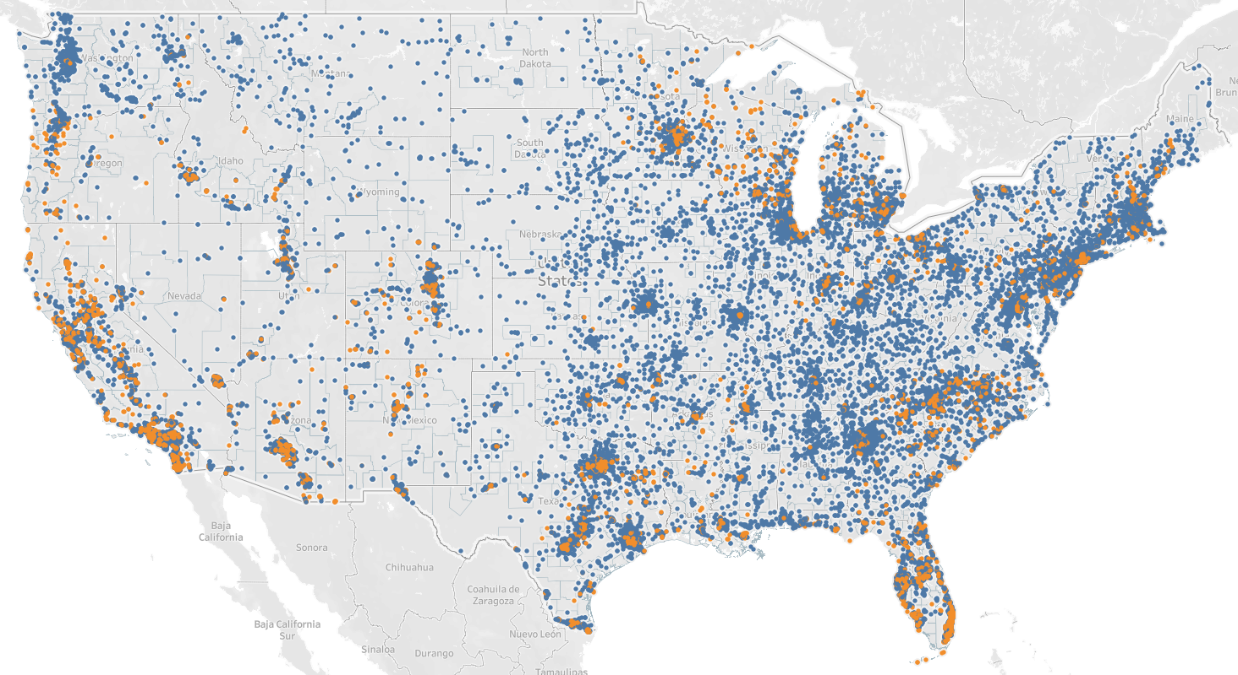
New schools have started in states across the country, though charters are more concentrated in certain states.
New Schools: 1990-91 to 2019-20
District school
Charter school
Source: NCES CCD. Note: Includes only schools in the 50 states plus the District of Columbia that had students enrolled in grades PK through 13. Excludes correctional facilities, district offices, hospital / homebound students, and schools that have fewer than 25 students in all years. A new school is defined here as a school with students enrolled in 2019-20 that had no students enrolled in 1989-90.

Slide 49
Appendix
Appendix 3
Trends over Time / Waves of School Reform

Slide 50
Over the past 30 years, the total number of public elementary and secondary schools in the United States has increased by over 12,000.
Public Schools and Students in the United States
(1989-90 to 2019-20)
Notes
Data are from the Common Core of Data (CCD) provided by the National Center for Education Statistics (NCES)
Includes only public elementary and secondary schools in the 50 states plus the District of Columbia.
Includes students in grades PK through 13, and excludes adult education students
Excludes correctional facilities, district offices, hospital/homebound students, and schools that never had 25 or more students in any year from 1989-90 to 2019-20
Students
Schools
1989-90
40,427,837
80,710
1999-00
46,583,761
+15%
87,588
+9%
2009-10
49,042,839
+5%
93,256
+6%
2019-20
50,394,842
+3%
93,502
+0%
+9,967,005
+25%
+12,792
+16%
Note: CCD data are submitted to the federal government by state education departments, and sometimes contain errors or omissions. We have reviewed the data and made corrections and adjustments where possible (e.g. merging NCES codes when one school has two codes). See appendix for details.

Slide 51
The net increase of 12,792 schools masks significant churn, as over 19,000 schools closed and nearly 32,000 opened over the past 30 years.
Number of Public Schools in the United States
(50 states & DC)
31,912
93,502
80,710
19,120
A school is defined as closing if it had at least one student enrolled in 1989-90 and none were enrolled in 2019-20
A school is defined as opening if it had no students enrolled in 1989-90 and had at least one student enrolled in 2019-20
Source: NCES Common Core of Data. Note: Includes only schools in the 50 states plus the District of Columbia that had students enrolled in grades PK through 13. Excludes correctional facilities, district offices, hospital/homebound students, and schools that have fewer than 25 students in all years.

Slide 52
Public school enrollment grew substantially in the 1990s and early 2000s, followed by more stability since the mid-2000s.
Enrollment and Schools
(1989-90 to 2019-20)
Number of Students
Number of Schools
1990s
Enrollment up 15%
# of Schools up 9%
2000s
Enrollment up 5%
# of Schools up 6%
2010s
Enrollment up 3%
# of Schools up 0%
Source: NCES Common Core of Data. Note: Includes only schools in the 50 states plus the District of Columbia that had students enrolled in grades PK through 13. Excludes correctional facilities, district offices, hospital/homebound students, and schools that have fewer than 25 students in all years. For New Jersey, this analysis assumes 1996-97 enrollment was the same as 1995-96 enrollment, because the state did not submit data to NCES in 1996-97.

Slide 53
Net new school growth peaked in the late 1990s, following years of high enrollment growth in the early to mid-1990s.
Annual Growth Enrollment and Schools
Annual % Increase
Source: NCES Common Core of Data. Note: Includes only schools in the 50 states plus the District of Columbia that had students enrolled in grades PK through 13. Excludes correctional facilities, district offices, hospital/homebound students, and schools that have fewer than 25 students in all years. For New Jersey, this analysis assumes 1996-97 enrollment was the same as 1995-96 enrollment, because the state did not submit data to NCES in 1996-97.

Slide 54
State-level data shows that, over the long run, enrollment growth is strongly related to net new school creation, though other factors are also important.
% Change in Students and Schools
45 degree line
% Change in Schools (1989-90 to 2019-20)
% Change in Students (1989-90 to 2019-20)
Source: NCES Common Core of Data. Note: Includes only schools in the 50 states plus the District of Columbia that had students enrolled in grades PK through 13. Excludes correctional facilities, district offices, hospital/homebound students, and schools that have fewer than 25 students in all years.

Slide 55
School closures grew during the first decade of the 2000s, after which both new school creation and school closures have declined.
Number of New and Closed Schools from Year to Year
1990s
Increase in new school creation; schools closures remain low
2000s
Increase in schools closing; new school creation still high
2010s
Both new school creation and closing drop in tandem
Number of Schools
Source: NCES CCD. Note: Includes only schools in the 50 states plus the District of Columbia that had students enrolled in grades PK through 13. Excludes correctional facilities, district offices, hospital / homebound students, and schools that have fewer than 25 students in all years. For New Jersey, this analysis assumes 1996-97 enrollment was the same as 1995-96 enrollment, because the state did not submit data to NCES in 1996-97. New Schools from the Prior Year includes any school that had at least one student enrolled in year t and no students enrolled in year t-1. Closed Schools from the Prior Year includes any school that had no students enrolled in year t and at least one student enrolled in year t-1. A school may appear multiple times in the analysis if it “opens” and “closes” multiple times.

Slide 56
During the years of our study, we identify three waves of new school creation.
Wave 1 (1990s):
Enrollment Growth
New schools were built to accommodate growing enrollment
Student enrollment increased by 15% and the number of schools increased by 9%
Substantial new school growth in states like Arizona, Nevada, and Florida with high student population growth
Wave 2 (2000s):
School Reform
The annual number of new schools created remained high, in part bolstered by charters, which accounted for ~20% of new schools
The number of school closures increased, such that by the end of the period, roughly as many schools were closing per year as were opening
The increase in closures may have been driven by various factors, including school reform efforts and the Great Recession of 2007-09
Wave 3 (2010s):
Stability & Charters
The number of new and closing schools declined in tandem, such that the total number of schools remained roughly flat
The number of new charters opened each year remained fairly stable, such that charters accounted for approximately 40% of new schools started in this period

Slide 57
Appendix
Appendix 4
Enrollment Growth and New School Creation

Slide 58
Background
In main analysis, we identified 31,912 new public schools that were open in 2019-20 and had started over the last three decades
7,079 of these schools were charter schools, representing 22% of all new schools opened since 1990
We would like to better understand the other 24,833 schools
  How many new schools appear to have been created largely due to population growth?
  How many new schools were created as part of a school reform / intentional design strategy?
While it’s hard to definitively answer these questions, we can inform them through two analyses
  A district-level analysis of enrollment growth and school opening/closing
  A school-level location analysis, identifying whether a new school is opening where another school previously existed

Slide 59
In some districts, new school creation appears driven by population growth…
Katy ISD, Texas
Montgomery County Public Schools, Maryland
Note: includes charter schools that are located within the geographic boundaries of the school district.

Slide 60
…while in other districts, population growth is clearly not a driver of new school creation.
Detroit Public School Community District, Michigan
Indianapolis Public Schools, Indiana
Note: includes charter schools that are located within the geographic boundaries of the school district.

Slide 61
Student enrollment growth is one factor helpful in distinguishing growth-based new school creation from school reform efforts.
Indianapolis
School Districts by Enrollment Growth
(1989-90 to 2019-20)
Montgomery
County
Number of School Districts
Katy ISD
Detroit
Enrollment Growth Between 1989-90 and 2019-20
Note: the upper end of each bin is included in the bin. For example, exactly 0% is included in the -25% to 0% bin.

Slide 62
The ratio of new schools created to schools closed is another relevant factor.
School Districts by Opened / Closed Ratio
(1989-90 to 2019-20)
Katy ISD
Montgomery
County
Number of School Districts
Detroit
Indianapolis
Schools Opened Between 1989-90 and 2019-20 / Schools Closed Between 1989-90 and 2019-20

Slide 63
In districts with high enrollment growth and a high ratio of opened to closed schools, new school creation is likely driven by enrollment growth.
50%
Clark County (NV)
High Enrollment Growth &
High Opened / Closed Ratio
Los
Angeles
Opened / Closed Ratio
Loudoun Co (VA)
Miami-
Dade
NYC
Houston
5
Detroit
Fulton County (GA)
Enrollment Growth (1989-90 to 2019-20)
Note: includes only districts that had at least one school open and one school close between 1989-90 and 2019-20. Size of bubble is proportional to 2019-20 enrollment.

Slide 64
In addition, for the majority of new schools, we can identify whether another school existed in the same location the prior year.
New schools in a new location – at least in areas with population growth and few schools closing – would seem likely to be created in response to population growth
Note: unknown schools represent those that could not be geocoded by address.

Slide 65
At least one-third of new schools were likely created due to enrollment pressure and at least one-third are unlikely to part of an enrollment growth story.
New Schools Opened Between 1989-90 and 2019-20
School Location Category
Likely created in response to enrollment growth (n = 9,967; 18% charters)
Unlikely created in response to enrollment growth (n = 10,304; 23% charters)
Unknown and/or a combination of factors (n = 11,641; 25% charters)
Note: Not applicable represent new schools in districts that did not exist in 1989-90.

Slide 66
Appendix
Appendix 5
New York City New School Maps by Decade

Slide 67
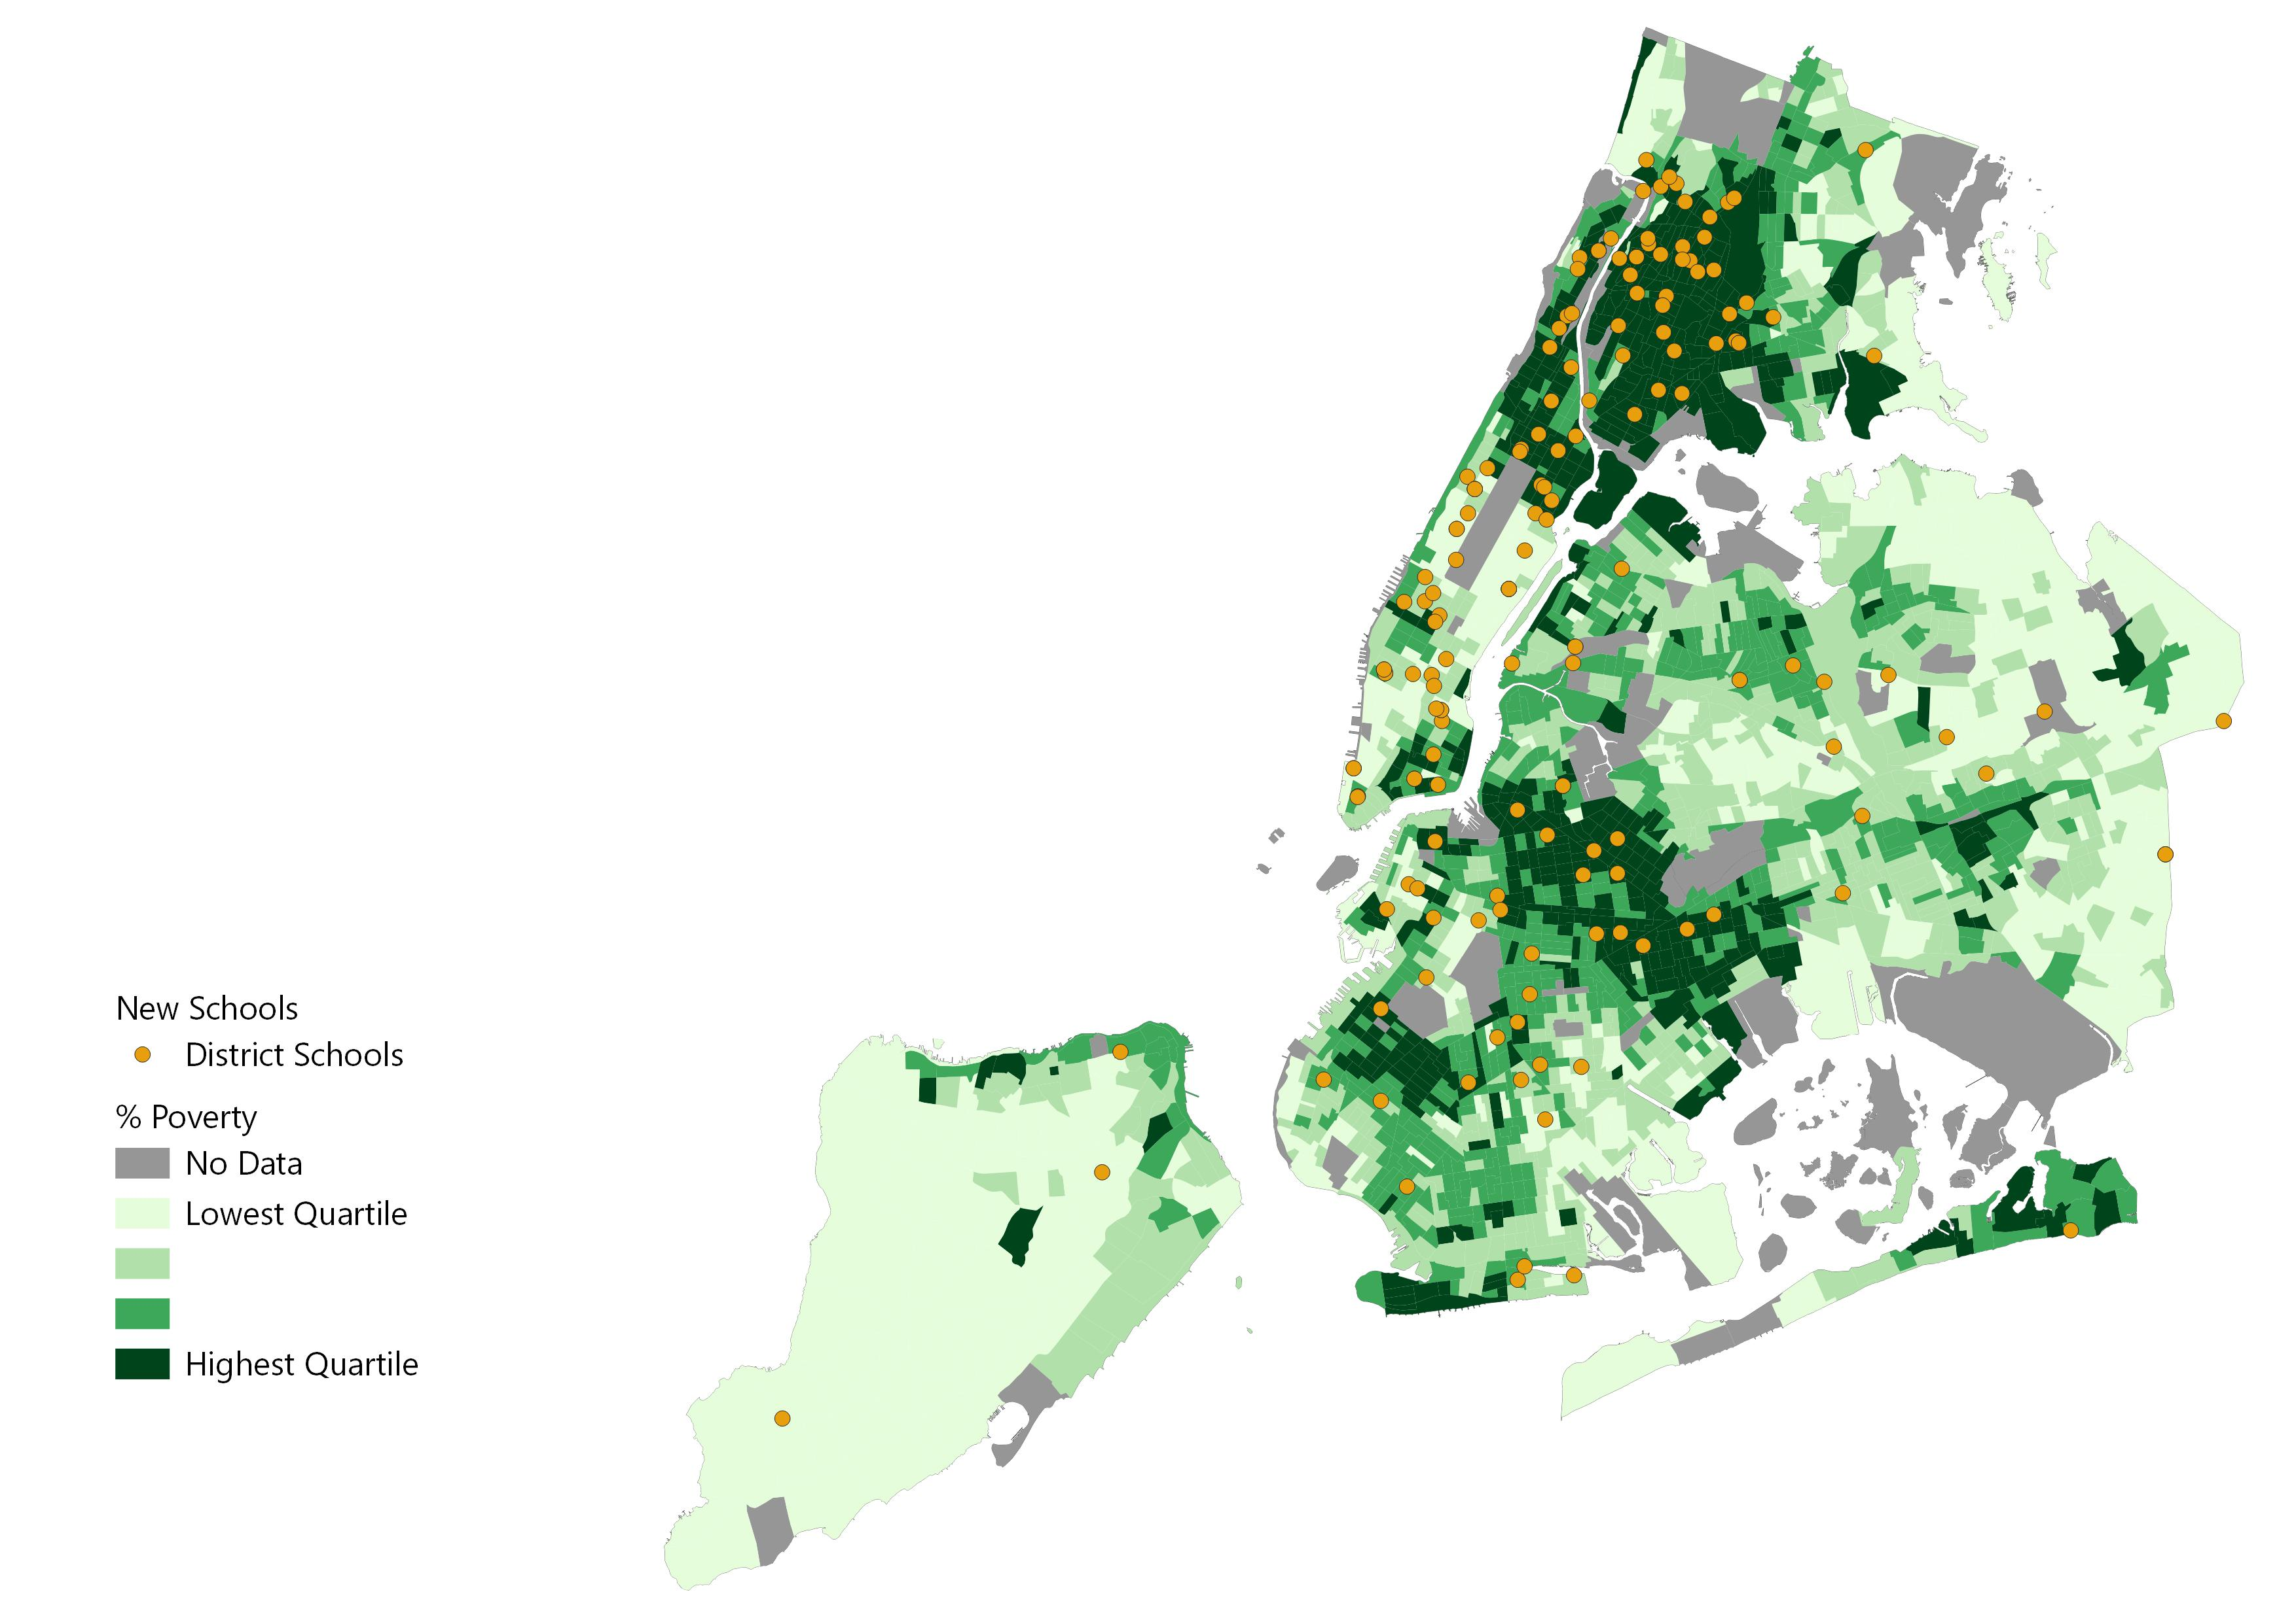
New Schools in New York City
(Opened from 1991 - 2000)
This map displays new schools that opened between 1991 to 2000 and were still open in 2020. Poverty rates by census tract in 1999 are shown.
66% (113/170) of new schools opened between 1991 and 2000 are in tracts that had above average poverty rates.
Note: Poverty Data are as of 1999. “Above average” means above the median, in this context. Percent Poverty is the proportion of individuals below the poverty level out of all individuals for whom poverty status is determined. Map includes schools that opened between 1990-91 and 1999-00. Sources: NHGIS (Poverty Data); NYC Open Data (Census Tract Shapefile); MarGrady Research (New school data).

Slide 68
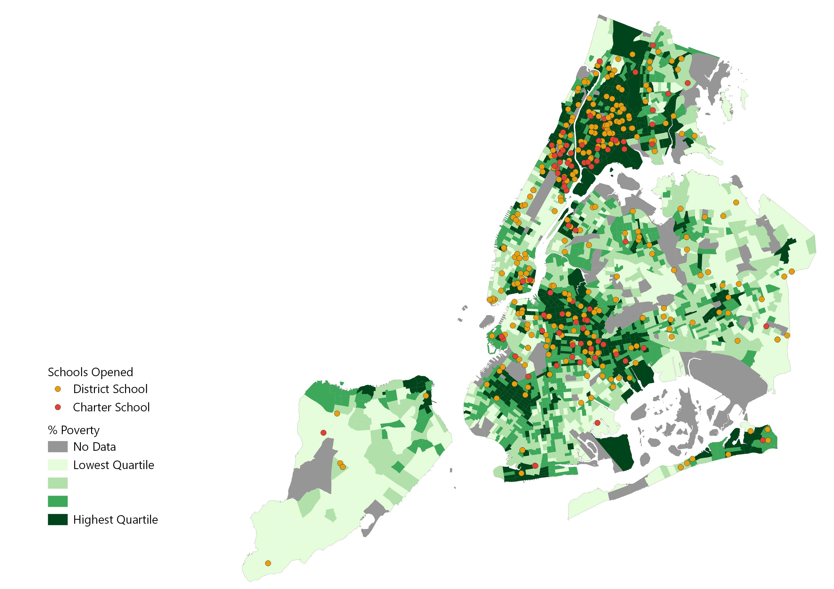
New Schools in New York City
(Opened from 2001 - 2010)
This map displays new schools that opened between 2001 and 2010 and were still open in 2020. Poverty rates by census track from 2006 to 2010 are shown.
From 2000 to 2010, 75% (383/513) of new schools opened in census tracts with above average poverty rates.
Note: Poverty Data are 2006-2010 5-year estimates. “Above average” means above the median, in this context. Percent Poverty is the proportion of individuals below the poverty level out of all individuals for whom poverty status is determined. Map includes schools that opened between 2000-01 and 2009-10. Sources: ACS (Poverty Data); NYC Open Data (Census Tract Shapefile); MarGrady Research (New school data).

Slide 69
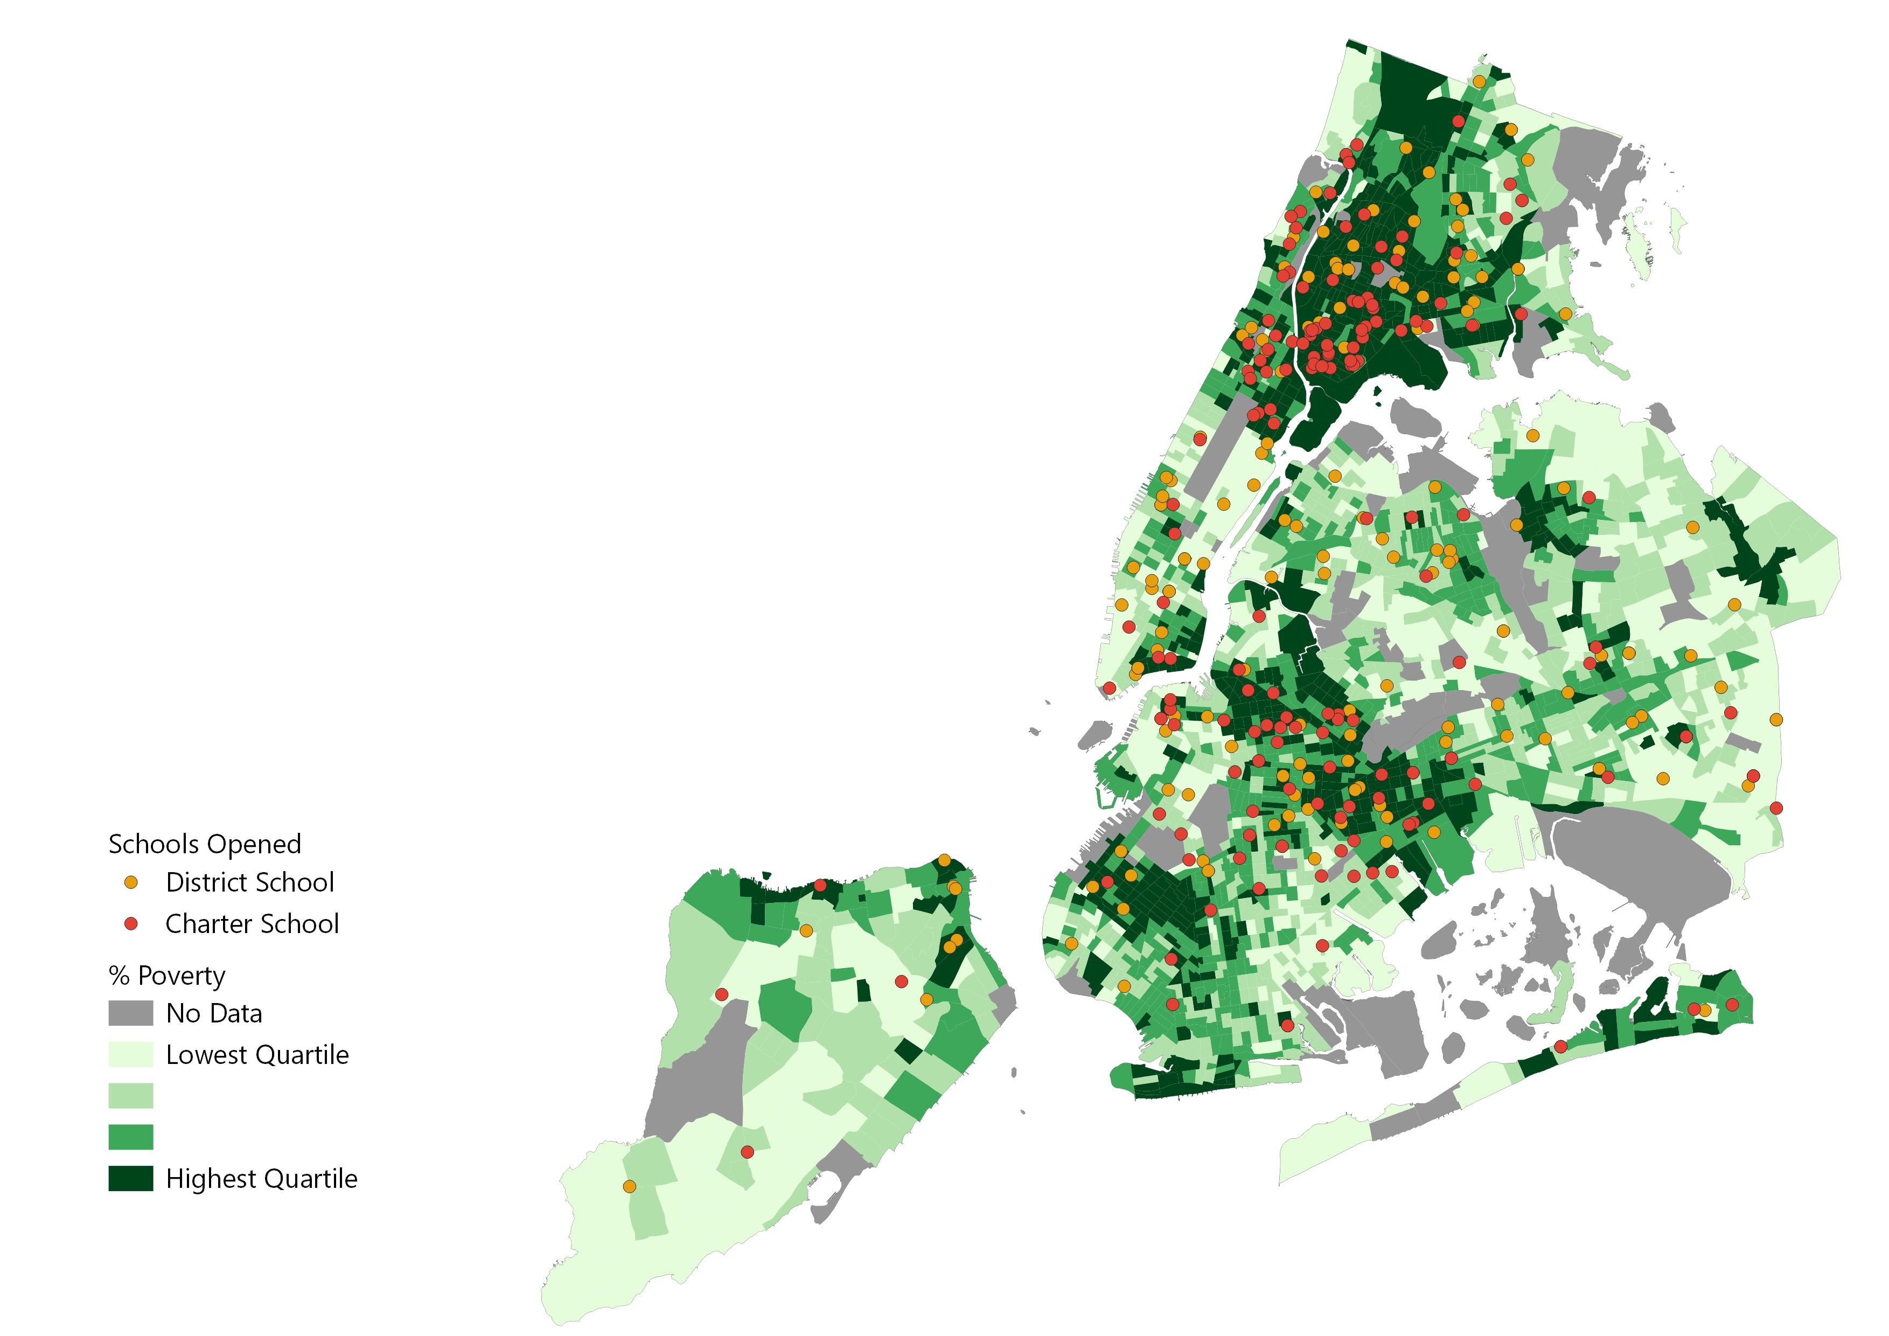
New Schools in New York City
(Opened from 2011 – 2020)
This map displays new schools that opened between 2011 and 2020 and were still open in 2020. Poverty rates by census track from 2015 to 2019 are shown.
From 2010 to 2020, 65% (240/367) of new schools opened in census tracts with above average poverty rates.
Note: Poverty Data are 2015-2019 5-year estimates. “Above average” means above the median, in this context. Percent Poverty is the proportion of individuals below the poverty level out of all individuals for whom poverty status is determined. Map includes schools that opened between 2010-11 and 2019-20. Sources: ACS (Poverty Data); NYC Open Data (Census Tract Shapefile); MarGrady Research (New school data).

Slide 70
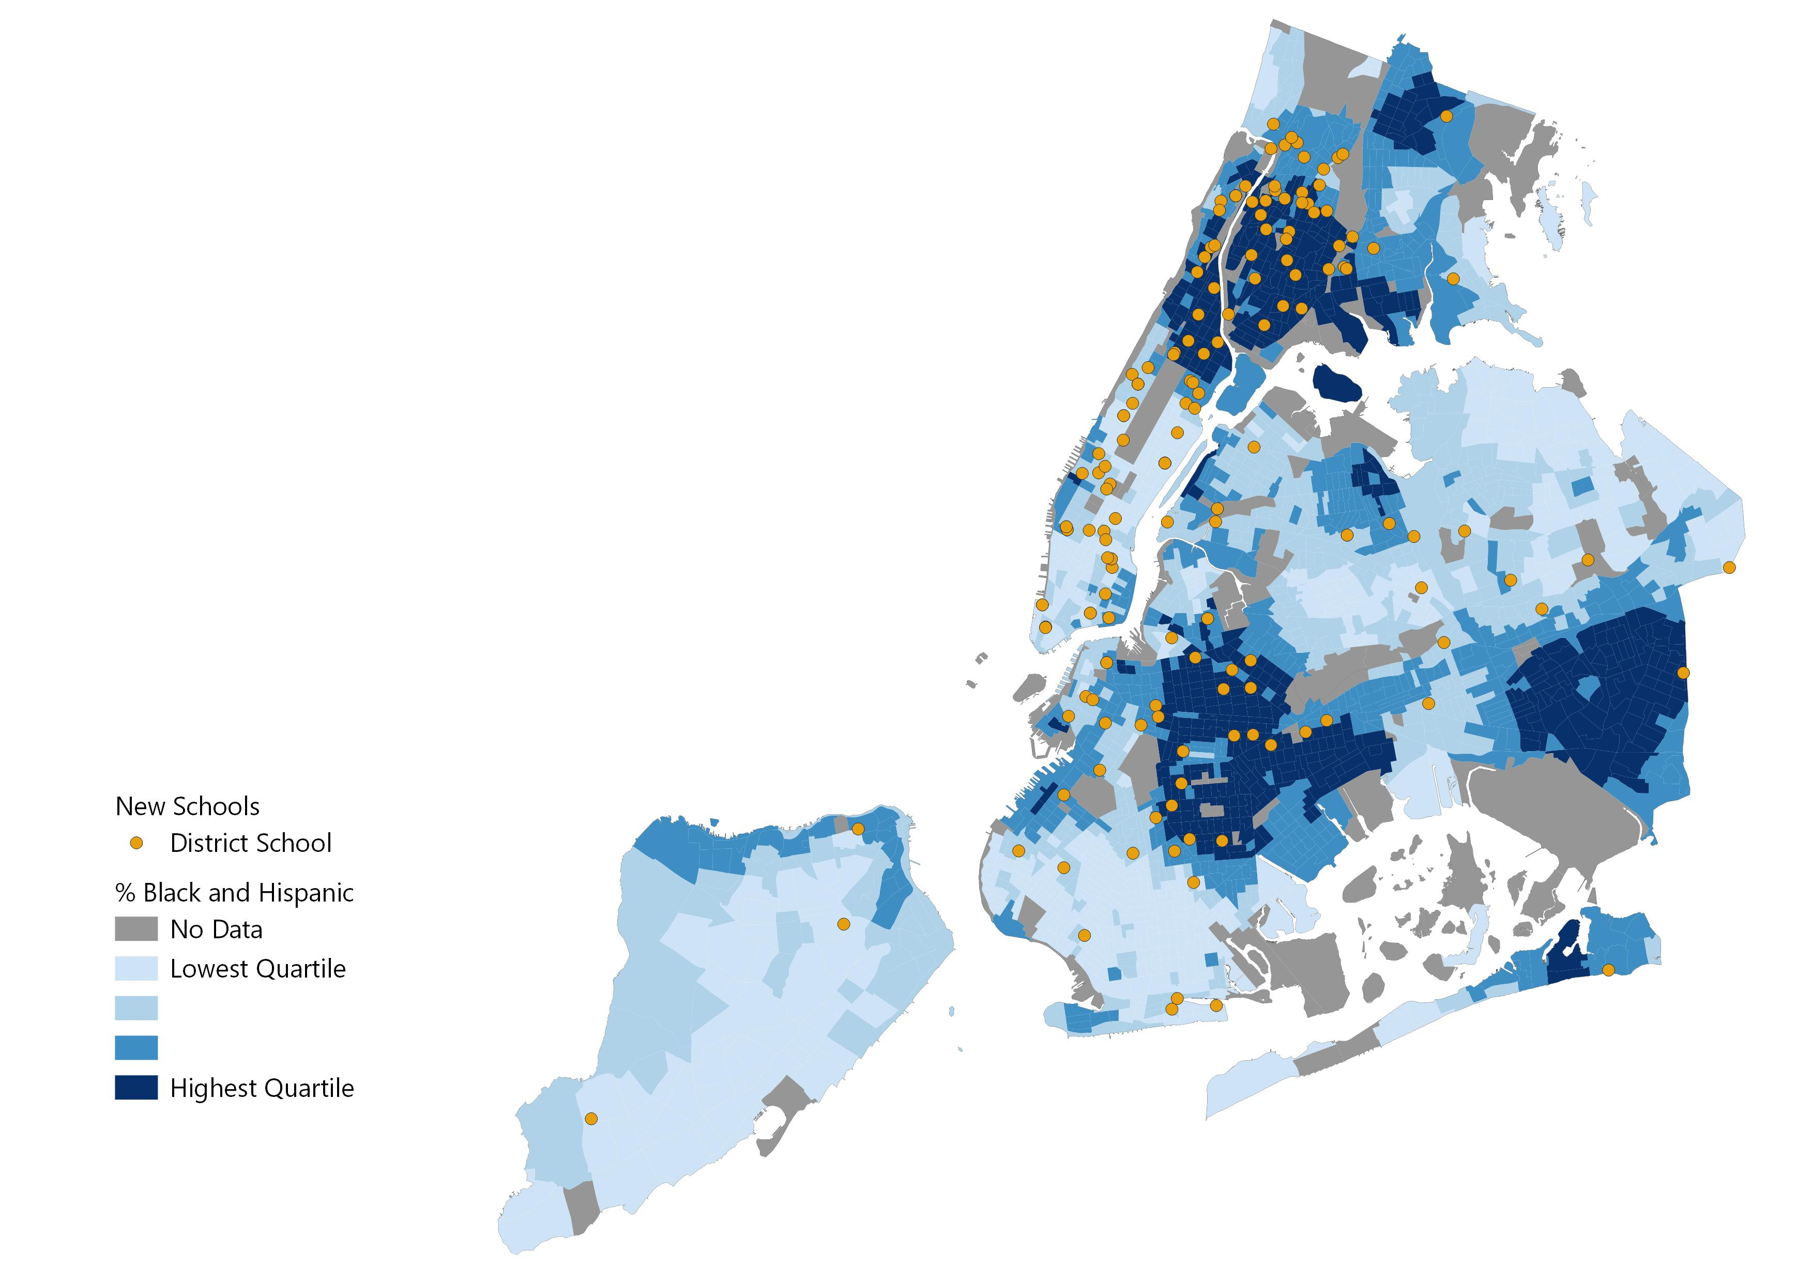
New Schools in New York City
(Opened from 1991 - 2000)
This map displays new schools that opened between 1991 to 2000 and were still open in 2020. Shading is based on % Black and Hispanic at the census tract level from 2000.
From 1990 to 2000, 60% (102/170) of new schools opened in census tracts with above average Black and Hispanic populations.
Note: Race data are as of 2000. “Above average” means above the median, in this context. Percent Black and Hispanic is the proportion of non-Hispanic Black individuals and Hispanic individuals of any race in the total population. Map includes schools that opened between 1990-91 and 1999-00. Sources: ACS (Race Data); NYC Open Data (Census Tract Shapefile); MarGrady Research (New school data).

Slide 71
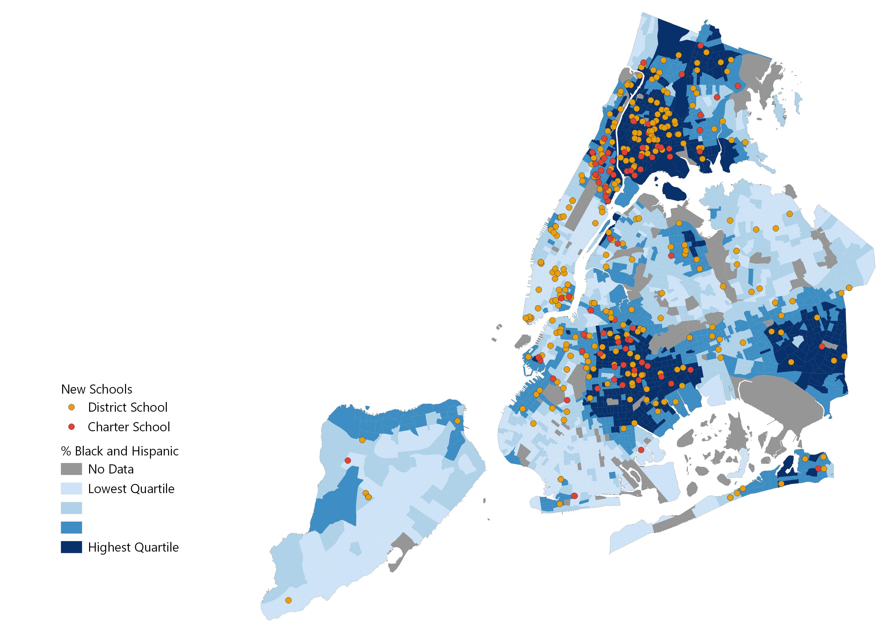
New Schools in New York City
(Opened from 2001 - 2010)
This map displays new schools that opened between 2001 to 2010 and were still open in 2020. Shading is based on % Black and Hispanic at the census tract level from 2010.
From 2000 to 2010, 77% (395/513) of new schools opened in census tracts with above average Black and Hispanic populations.
Note: Race data are as of 2010. “Above average” means above the median, in this context. Percent Black and Hispanic is the proportion of non-Hispanic Black individuals and Hispanic individuals of any race in the total population. Map includes schools that opened between 2000-01 and 2009-10. Sources: ACS (Race Data); NYC Open Data (Census Tract Shapefile); MarGrady Research (New school data).

Slide 72
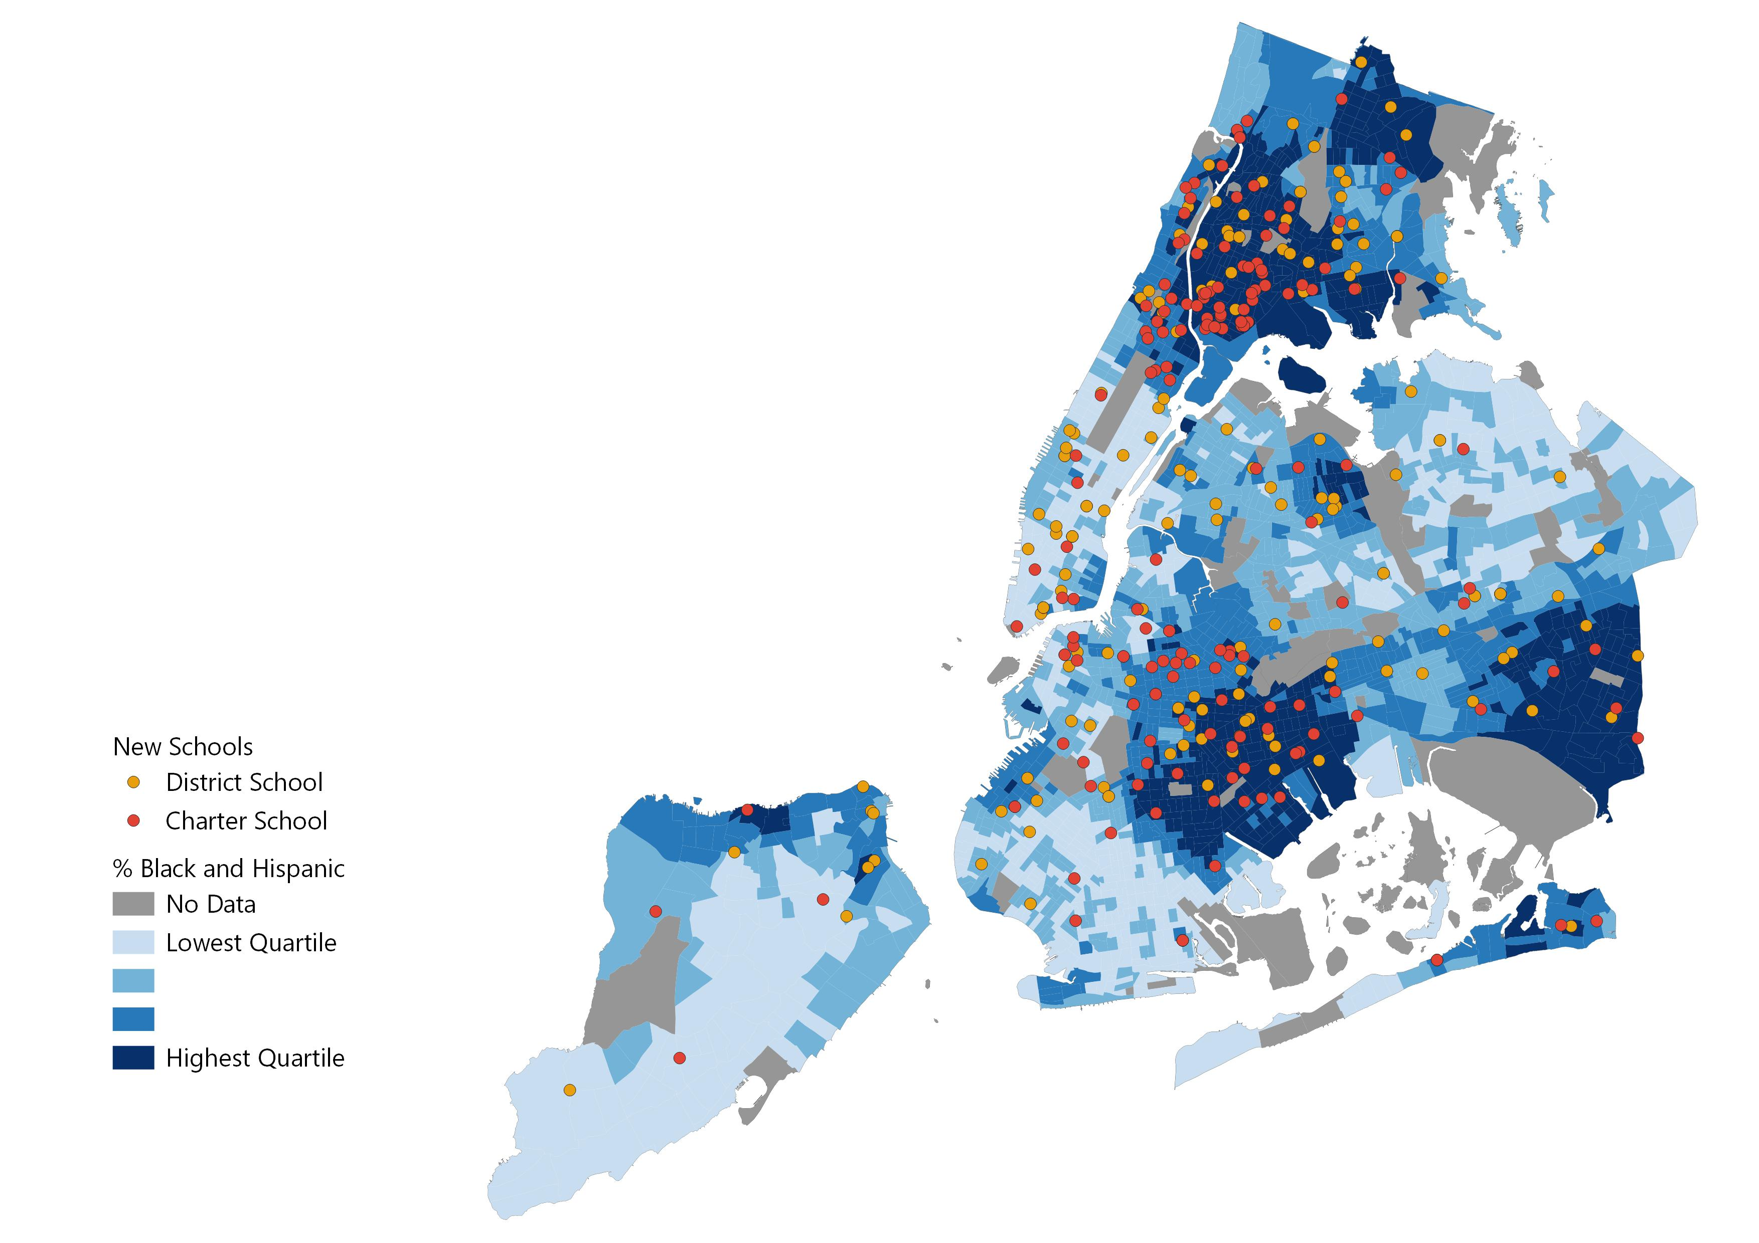
New Schools in New York City
(Opened from 2011 – 2020)
This map displays new schools that opened between 2011 to 2020 and were still open in 2020. Shading is based on % Black and Hispanic at the census tract level from 2019.
From 2010 to 2020, 74% (270/367) of new schools opened in census tracts with above average Black and Hispanic populations.
Note: Race data are as of 2019. “Above average” means above the median, in this context. Percent Black and Hispanic is the proportion of non-Hispanic Black individuals and Hispanic individuals of any race in the total population. Map includes schools that opened between 2010-11 and 2019-20. Sources: ACS (Race Data); NYC Open Data (Census Tract Shapefile); MarGrady Research (New school data).

